Slide 1
Topic: Perception
Dr. C. Vijaya Banu
Professor , School of Management
SASTRA Deemed University, Thanjavur – 613 401
vijayabanu@mba.sastra.edu

Slide 2
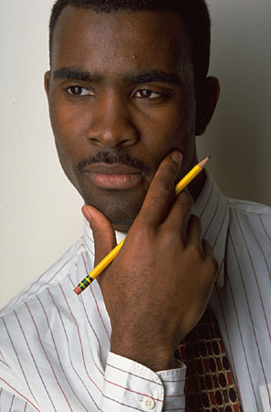
Perception
A process by which individuals organize and interpret their sensory impressions in order to give meaning to their environment.
The world as it is perceived is the world that is behaviorally important.

Slide 3
Perception
The study of perception is concerned with identifying the processes through which we interpret and organize sensory information to produce our conscious experience of objects
and object relationship.
Perception is the process of receiving information about and making sense of the world around us. It involves deciding which information to notice, how to categorize this information, and how to interpret it within the framework of our existing knowledge.
sensation is the first step in the perceptual process. Sensation and other steps constitute the total perceptual process.

Slide 4
Perceptual Process Model
Environmental Stimuli
Feeling Hearing Seeing Smelling Tasting
Selective Attention
Organization and
Interpretation
Emotions and
Behavior

Slide 5
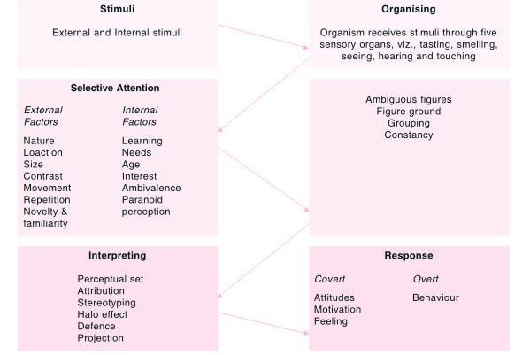
Perceptual Process

Slide 6
Attribution Theory
Attribution theory an attempt to determine whether an individual’s behavior is internally or externally caused.
Fundamental attribution error the tendency to underestimate the influence of external factors and overestimate the influence of internal factors when making judgments about the behavior of others.
Self-serving bias the tendency for individuals to attribute their own successes to internal factors and put the blame for failures on external factors.
Humans are motivated to assign causes to their actions and behaviors. In social psychology, attribution is the process by which individuals explain the causes of behavior and events. Models to explain this process are called attribution theory

Slide 7
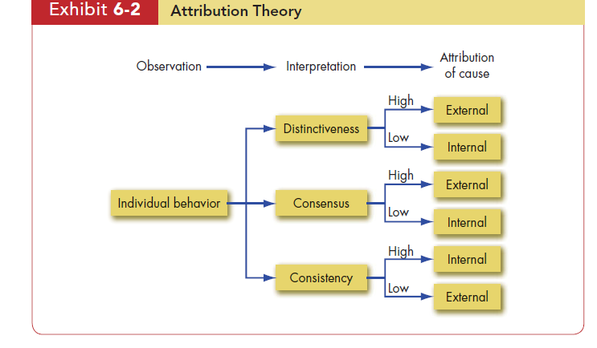
Humans are motivated to assign causes to their actions and behaviors. In social psychology, attribution is the process by which individuals explain the causes of behavior and events. Models to explain this process are called attribution theory

Slide 8
Attribution Theory
Distinctiveness refers to whether an individual displays different behaviors in different situations
If everyone who faces a similar situation responds in the same way, we can say the behavior shows Consensus
Consistency in a person’s actions. Does the person respond the same way over time

Slide 9
Attribution Theory
Judgments about what caused a person’s behavior—either characteristics of the person or of the situation
As people organize what they perceive, they often draw conclusions
Suggests that when we observe an individual’s behavior, we attempt to determine whether it was internally or externally caused
Internally – believed to be under the personal control of the individual
Externally – resulting from outside causes

Slide 10
Attribution Errors
Fundamental Attribution Error – when we make judgments about the behavior of others, we tend to underestimate external influence and overestimate internal influence
Self-serving Bias – we tend to attribute our own success to internal factors and put the blame for failure on external factors

Slide 11
Common Perceptual Distortions
1. Stereotyping
Tendency to assign an individual to a group or broad category and then attribute generalizations about the group to the individual

Slide 12
Common Perceptual Distortions
2. Halo Effect
Halo Effect – drawing a general impression based on a single characteristic
Overall impression of a person or situation based on one characteristic, either favorable or unfavorable

Slide 13
Common Perceptual Distortions
3. Projection
Tendency to see one’s own personal traits in other people
Contrast Effects – our reaction is influenced by others we have recently encountered

Slide 14
Common Perceptual Distortions
4. Perceptual Defense - Tendency of perceivers to protect themselves by disregarding ideas objects, or people that are threatening to them
5. Selective Perception – a characteristic that makes someone stand out in our mind will increase the probability that it will be perceived
6.Central tendency error
7. Leniency error
8. Primacy Effect
9.Similar to me effect
10. A self-fulfilling prophecy-A self-fulfilling prophecy is the socio psychological phenomenon of someone "predicting" or expecting something, and this "prediction" or expectation coming true simply because the person believes it will and the person's resulting behaviors aligning to fulfill the belief

Slide 15
Common Biases and Errors
Overconfidence Bias
Believing too much in our own decision competencies.
Anchoring Bias
Fixating on early, first received information.
Confirmation Bias
Using only the facts that support our decision.
Availability Bias
Using information that is most readily at hand.
Representative Bias
Assessing the likelihood of an occurrence by trying to match it with a preexisting category.

Slide 16
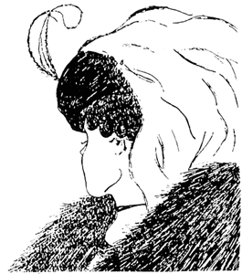

Slide 17


Slide 18
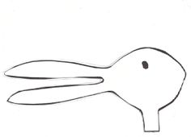

Slide 19
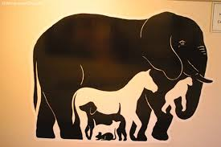

Slide 20
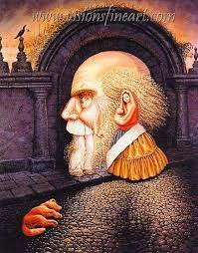

Slide 21
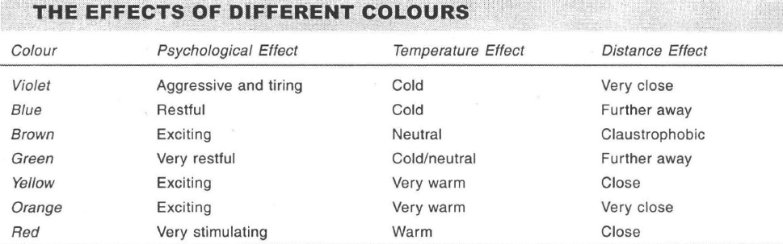

Slide 22
Thank You

Slide 27
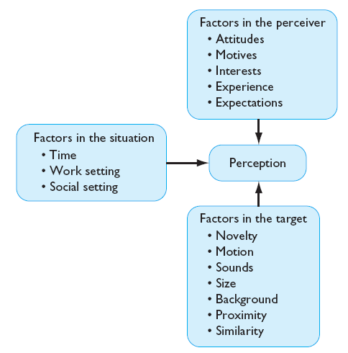
Factors Influencing Perception

Slide 28
Perception
Perceptual Selectivity: process by which individuals screen and select various stimuli that vie for their attention
Primacy (toward beginning)
Recency (toward end of event)
selective perception The tendency to selectively interpret what one sees on the basis of one’s interests, background, experience, and attitudes.
Perception Process: Cognitive process used to make sense out of the environment (3 steps)
Observe information via senses
Screen information & select what to process
Organize selected data into patterns
Perceptual Distortions: errors in perceptual judgment arising from inaccuracies in any part of the perceptual process
Common Errors:
Stereotyping When we judge someone on the basis of our perception
of the group to which he or she belongs, we are using the shortcut called
stereotyping
Halo effect-halo effect The tendency to draw a general impression about an individual on the basis of a single characteristic

Slide 29
Assumptions of the Rational Decision-Making Model
Rational Decision- Making Model
Describes how individuals should behave in order to maximize some outcome.
Model Assumptions
Problem clarity
Known options
Clear preferences
Constant preferences
No time or cost constraints
Maximum payoff

Slide 30
Steps in the Rational Decision-Making Model
Define the problem.
Identify the decision criteria.
Allocate weights to the criteria.
Develop the alternatives.
Evaluate the alternatives.
Select the best alternative.
E X H I B I T 5–3

Slide 31
How Are Decisions Actually Made in Organizations
Bounded Rationality
Individuals make decisions by constructing simplified models that extract the essential features from problems without capturing all their complexity.

Slide 32
Common Biases and Errors
Escalation of Commitment
Increasing commitment to a previous decision in spite of negative information.
Randomness Error
Trying to create meaning out of random events by falling prey to a false sense of control or superstitions.
Hindsight Bias
Falsely believing to have accurately predicted the outcome of an event, after that outcome is actually known.
Central tendency error
‘Similar like me’ error
Recency error/ Leniency/Primacy error

Slide 33
Intuition
Intuitive Decision Making
An unconscious process created out of distilled experience.
Conditions Favoring Intuitive Decision Making
A high level of uncertainty exists
There is little precedent to draw on
Variables are less scientifically predictable
“Facts” are limited
Facts don’t clearly point the way
Analytical data are of little use
Several plausible alternative solutions exist
Time is limited and pressing for the right decision

Slide 34
Individual Differences in Decision Making
Personality
Aspects of conscientiousness and escalation of commitment.
Self Esteem High self serving bias
Gender
Women tend to analyze decisions more than men.

Slide 35
Organizational Constraints on Decision Makers
Performance Evaluation
Evaluation criteria influence the choice of actions.
Reward Systems
Decision makers make action choices that are favored by the organization.
Formal Regulations
Organizational rules and policies limit the alternative choices of decision makers.
System-imposed Time Constraints
Organizations require decisions by specific deadlines.
Historical Precedents
Past decisions influence current decisions.

Slide 36
Cultural Differences in Decision Making
Problems selected
Time orientation
Importance of logic and rationality
Belief in the ability of people to solve problems
Preference for collect decision making

Slide 37
Ethics in Decision Making
Ethical Decision Criteria
Utilitarianism
Seeking the greatest good for the greatest number.
Rights
Respecting and protecting basic rights of individuals such as whistleblowers.
Justice
Imposing and enforcing rules fairly and impartially.

